Slide 1
OOPs in Java

Slide 2
Afreen
B.E. Computers
4 years
Industry experience
4 years
Teaching/training experience

Slide 3
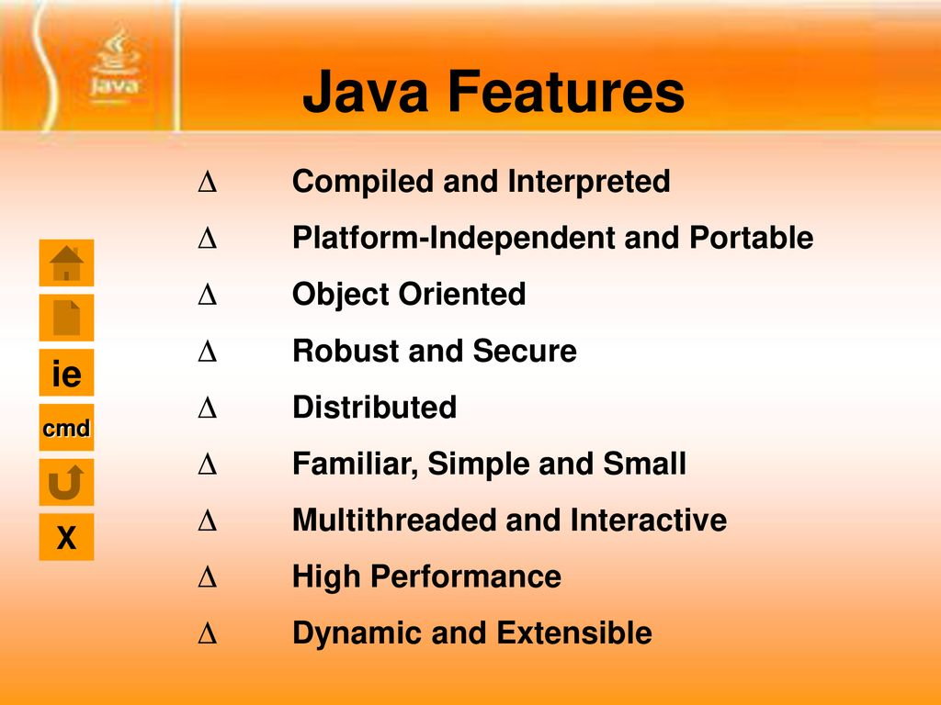
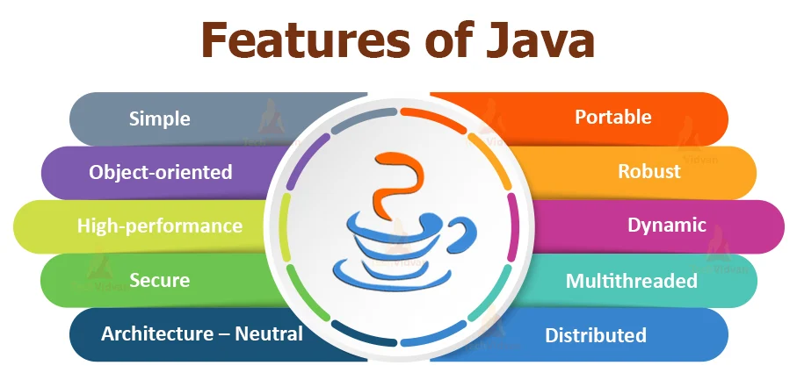
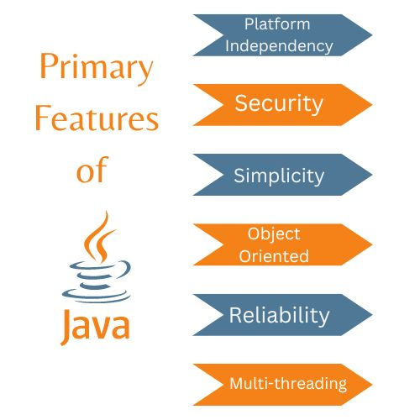
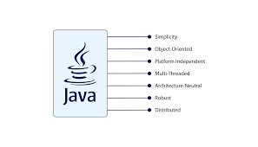
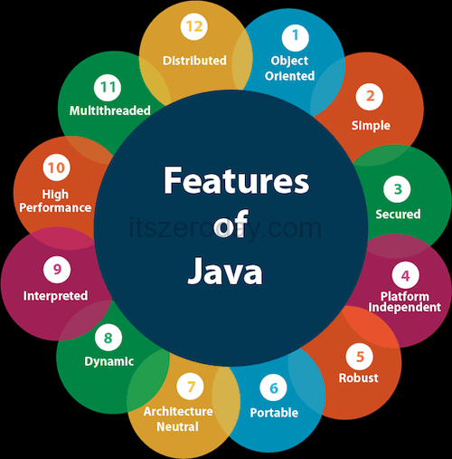
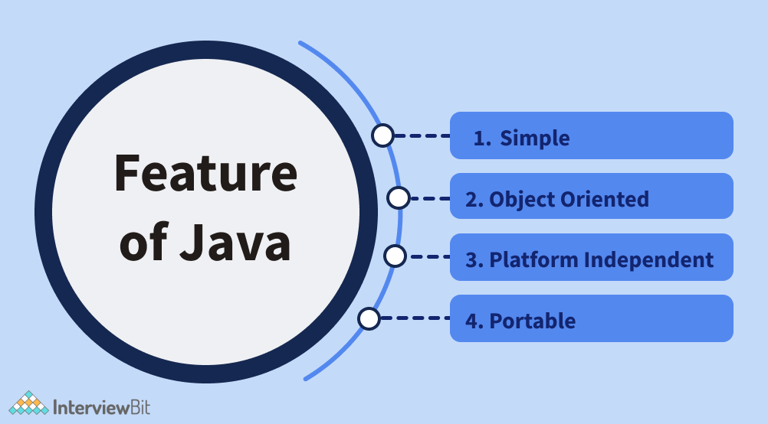
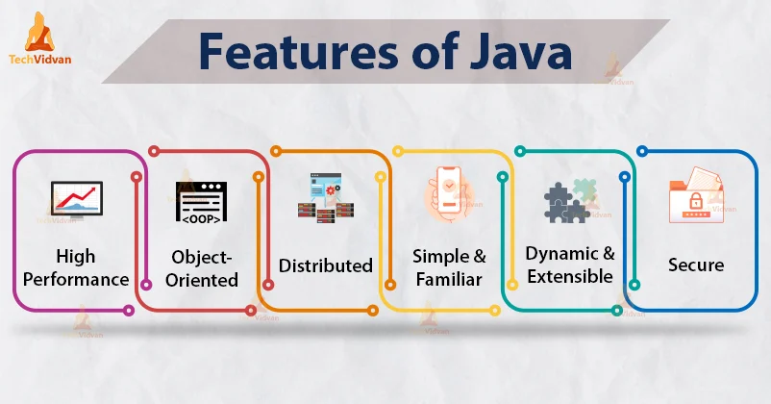

Slide 4
Topics
What is OOPs?
Fundamental concepts of OOPs
Object
Class
Class vs Object
Pillars of OOPs
Inheritance
Types of Inheritance
Encapsulation
Access Modifiers
Abstraction
Polymorphism
OOPs vs POPs

Slide 5

Object Oriented Programming
Definition: The object-oriented programming is basically a computer programming design philosophy or methodology that organizes/ models software design around data, or objects.
For large, complex and actively updated or maintained programs.
We create a model for a real world system.

Slide 6

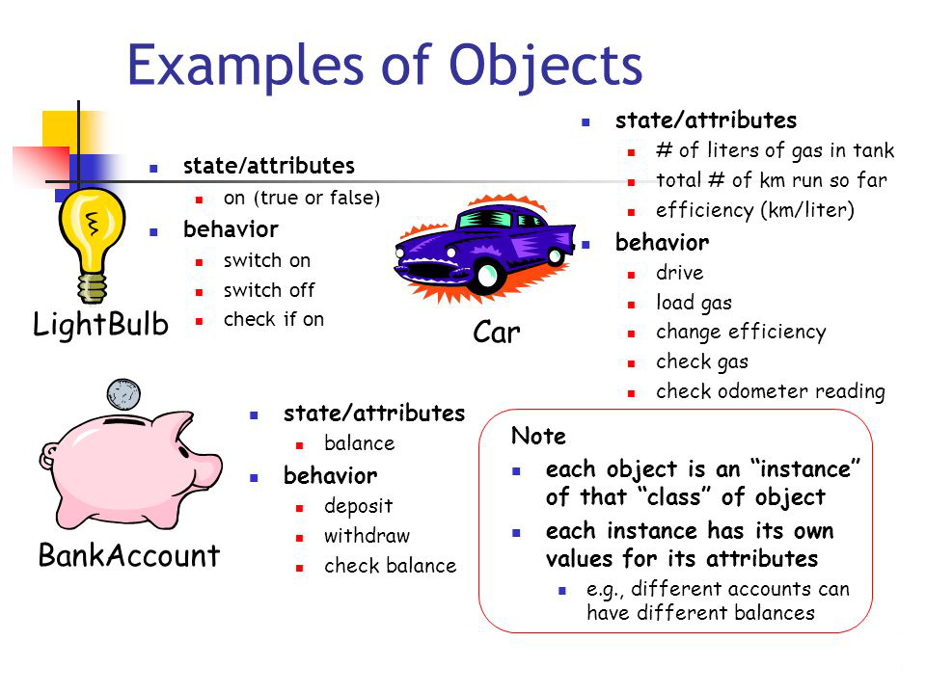
Objects
Definition: Object means a real-world entity such as a pen, chair, table, computer, watch, etc.
It can be physical or logical. Eg. bank account, courses, shopping cart etc.
Objects have properties and objects perform tasks.

Slide 7
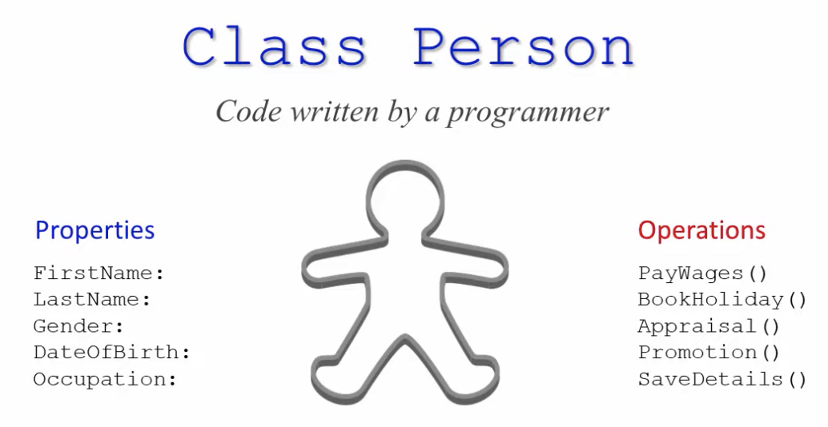
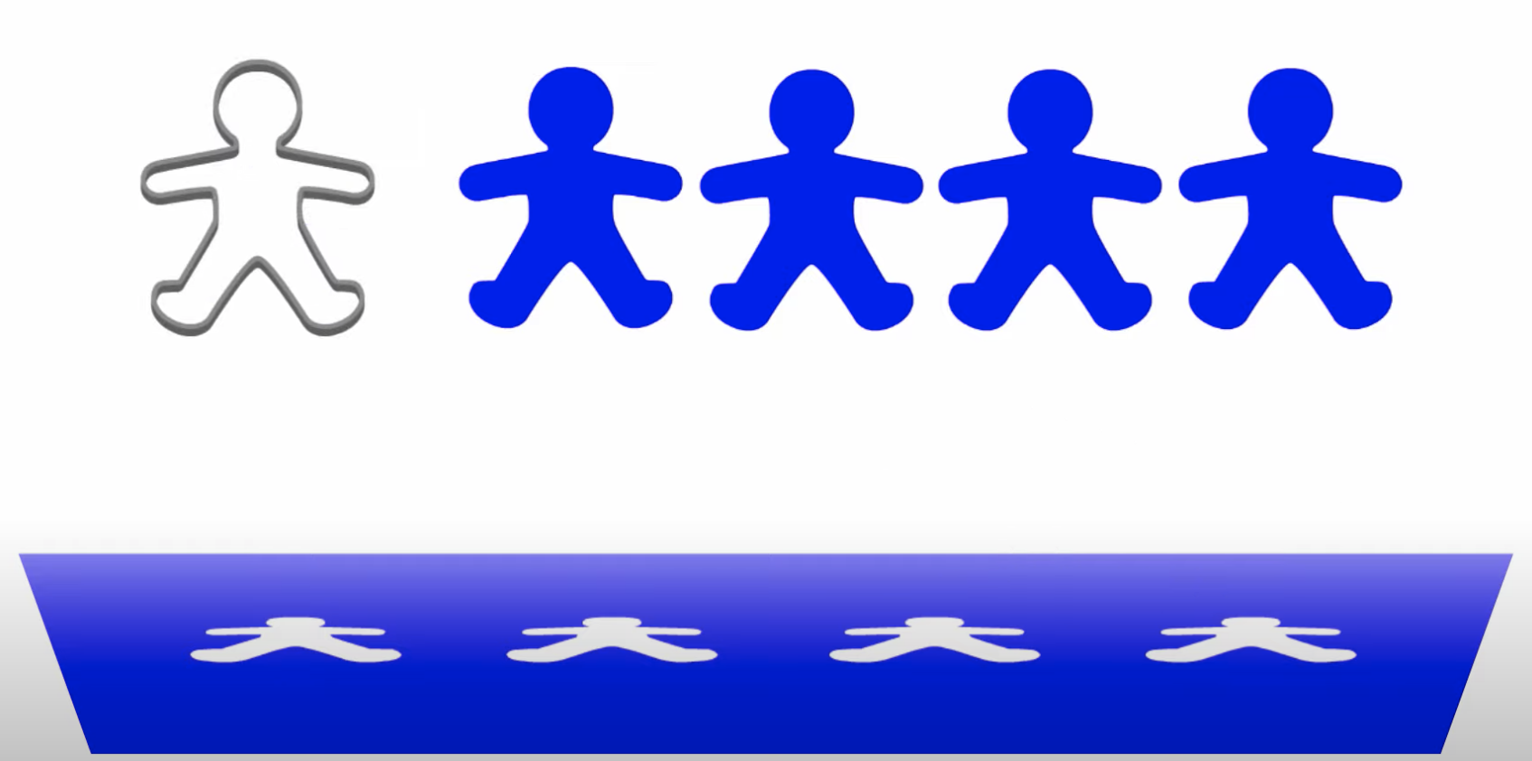
Class
Class is a user defined data type
It is fundamental packaging unit of OOP technology.
It is called as a template of an object OR a Blueprint of an object OR a drawing of an object

Slide 8
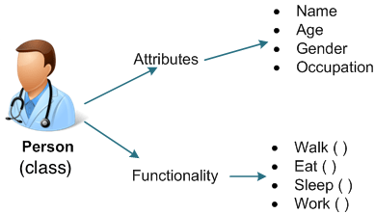
Class
Fields
Methods
Fields describe what a class is.
Method describes what a class does.

Slide 9

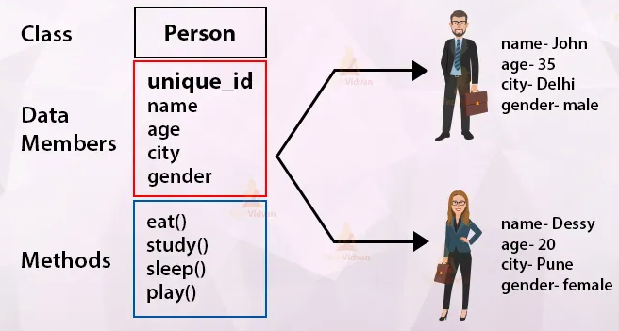
Classes and Objects
An object is an instance of a class.
Different objects of the same class will have the same fields and methods, but the values of the fields in general would differ.

Slide 10
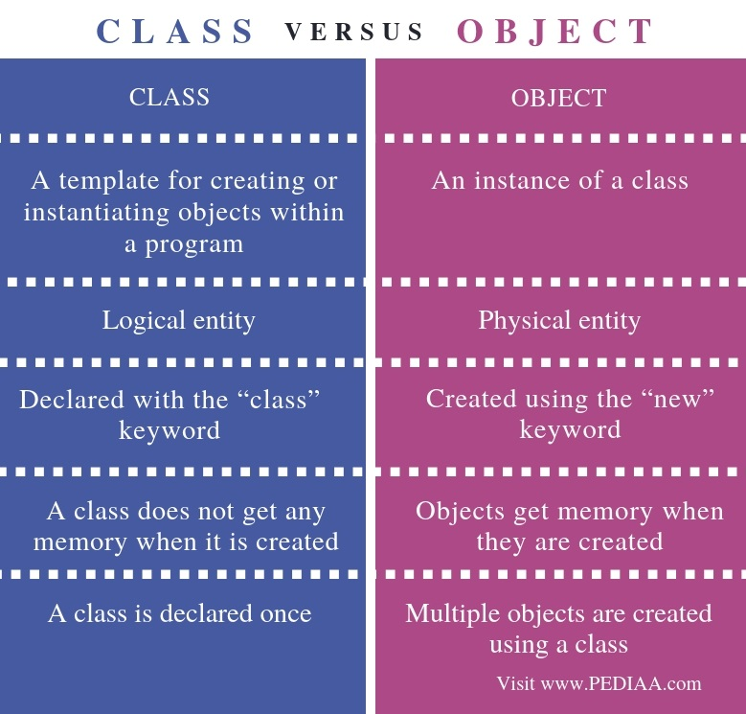
Notes:
class Student{
String Name;
int RollNo;
public void ShowDetails(){
System.out.println("Student name is " +Name+ " and roll number is " +RollNo);
}
}
public class Main {
public static void main(String[] args) {
Student Tom = new Student();
Tom.Name="Tom";
Tom.RollNo=1;
Tom.ShowDetails();
System.out.println();
Student Jerry = new Student();
Jerry.Name="Jerry";
Jerry.RollNo=2;
Jerry.ShowDetails();
}
}

Slide 11


Slide 12
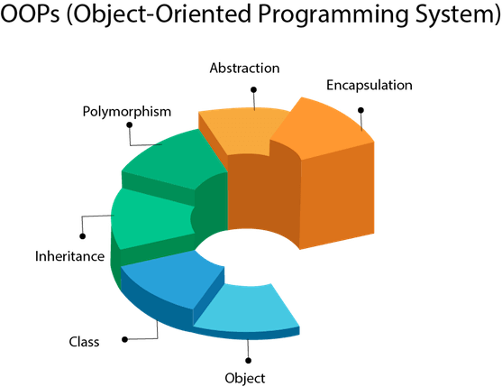

Slide 13
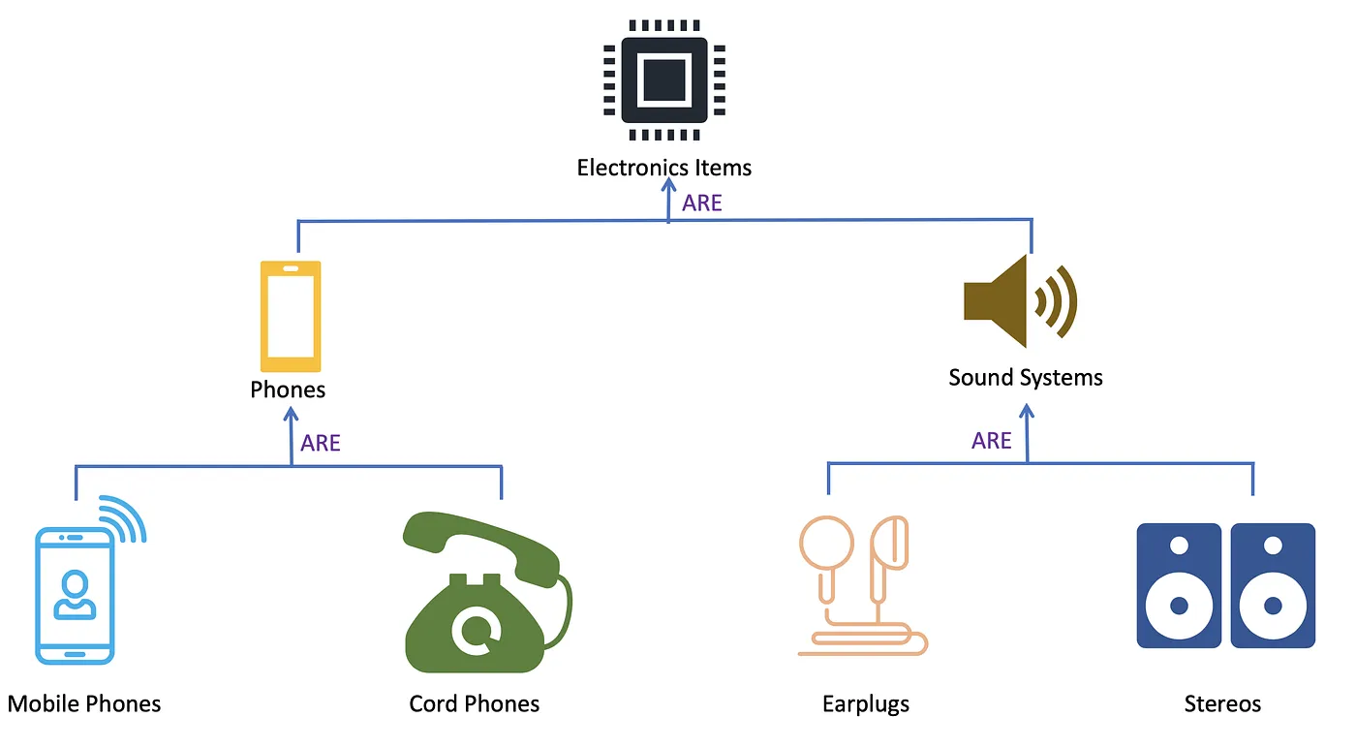
Inheritance
Definition: Inheritance is a process by which objects of one class acquires the properties of objects of another class.
Concept of inheritance provides the idea of reusability and extensibility.
Class A
Base class
Derived class
Parent class
Child class
Super class
Sub class
Extends
Class B
Notes:
class Vehicle {
String brand = "Ford";
public void honk() {
System.out.println("Tuut, tuut!");
}
}
class Car extends Vehicle {
String modelName = "Mustang";
}
public class Main{
public static void main(String[] args) {
Car myCar = new Car();
myCar.honk();
System.out.println(myCar.brand + " " + myCar.modelName);
}
}

Slide 14
Types of inheritance
Single inheritance
Multilevel inheritance
Hierarchical inheritance
Notes:
Single- Dog–Animal
Multilevel- watch–titan–raga
Hierarchical- Sports–Hockey, Football, Cricket

Slide 15
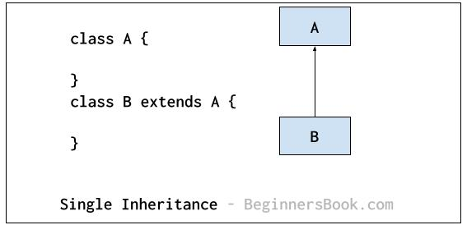
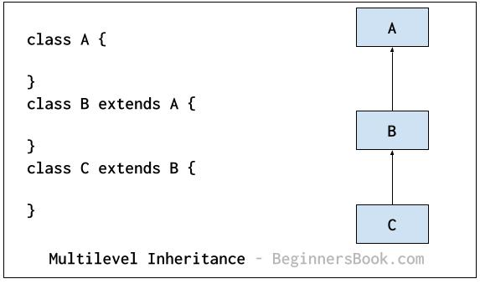
Single Inheritance
Multilevel Inheritance

Slide 16
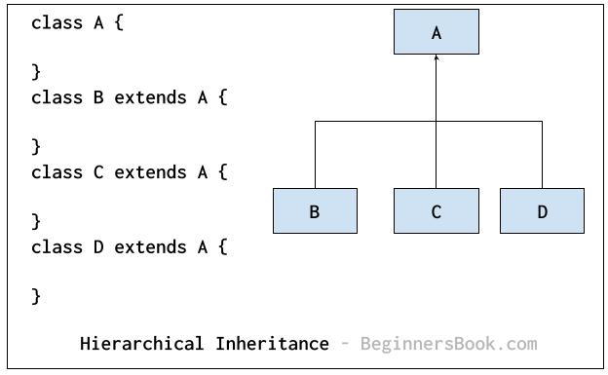
Hierarchical Inheritance

Slide 18

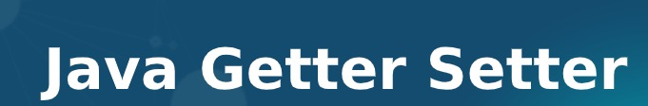
Encapsulation
Definition: Binding (or wrapping) code and data together into a single unit are known as encapsulation.
By encapsulating a class's variables, other classes cannot access them, and only the methods of the class can access them.
Data hiding is a procedure done to avoid access to the data members and data methods and their logical implementation.
Encapsulation gives us better control on our code and improves security.
Difference between encapsulation and data hiding is that Encapsulation is a way of bundling data whereas Data Hiding prevents external unauthorized access to the sensitive data.

Slide 19
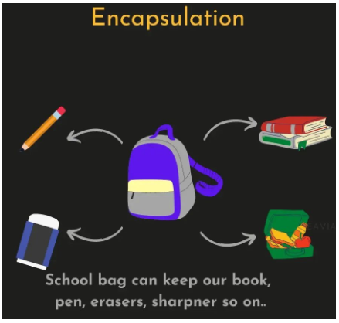

Slide 20
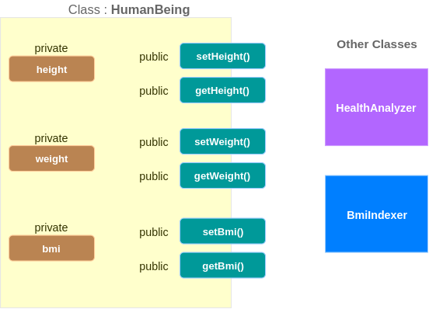
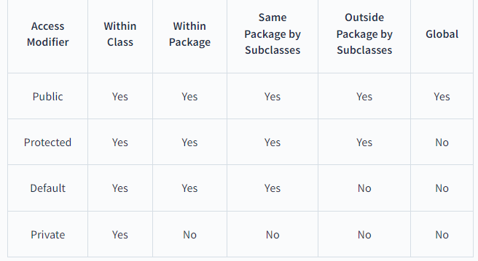
Access Modifiers: Access modifiers or access specifiers are the keywords in object oriented languages. It helps to set the accessibility of classes, methods and other members.

Slide 21
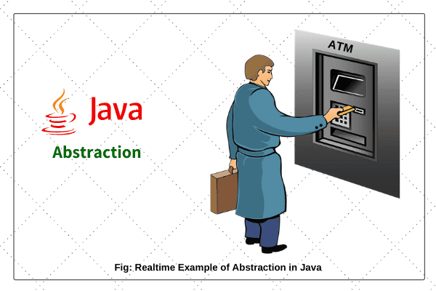


Abstraction
Definition: Data Abstraction is the property by virtue of which only the essential details are displayed to the user. The trivial or non-essential units are not displayed to the user.
Hiding internal details and showing functionality is known as abstraction.
In Java, we use abstract class and interface to achieve abstraction.

Slide 22
Abstract class:
declared with the keyword abstract
We can't create object for abstract class.
It may or may not contain abstract methods.
It can have abstract and non abstract methods.
To use an abstract class, you have to inherit it from sub-classes.
If a class contain partial implementation than we should declare a class as abstract.

Slide 23
Abstract Methods :
An abstract method is declared inside abstract class
If any method is abstract in a class, the class must be declared as abstract.
Does not have a definition or implementation.
Method name and signature must be the same as in the abstract class.
It cannot be private because the abstract method must be implemented in the subclass.
Abstract method cannot be static or final.

Slide 24
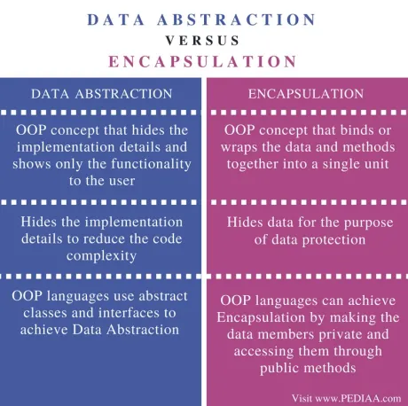

Slide 25

Polymorphism
Polymorphism is a Greek term where poly means many, morph means form.
It simply means ‘one name multiple forms’.
In Java, we use method overloading and method overriding to achieve polymorphism.
RUN
Notes:
class Animal {
public void animalSound() {
System.out.println("The animal makes a sound");
}
}
class Cat extends Animal {
public void animalSound() {
System.out.println("The cat says: mew mew");
}
}
class Dog extends Animal {
public void animalSound() {
System.out.println("The dog says: bow wow");
}
}
public class Main {
public static void main(String[] args) {
Animal myAnimal = new Animal();
Animal myCat = new Cat();
Animal myDog = new Dog();
myAnimal.animalSound();
myCat.animalSound();
myDog.animalSound();
}
}

Slide 26
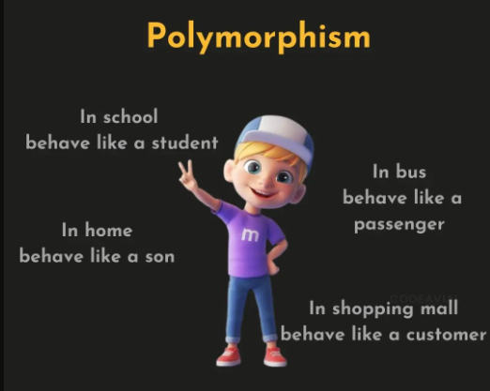

Slide 27
Polymorphism
Compile time
OR
Static polymorphism
Run time
OR
Dynamic polymorphism
Method overloading
Method overriding

Slide 28
Method overloading
If a class has multiple methods having same name but different in parameters, it is known as Method Overloading.
Rules for Java Method Overloading
By changing number of arguments
By changing the data type
By changing the sequence of arguments

Slide 29
Method overriding
If subclass (child class) has the same method as declared in the parent class, it is known as method overriding in Java.
Rules for Java Method Overriding
The method must have the same name as in the parent class
The method must have the same parameter as in the parent class.
There must be an IS-A relationship (inheritance).
If a method cannot be inherited, then it cannot be overridden.

Slide 30
Method overloading | Method overriding
Also known as static binding or early binding | Also known as dynamic binding or late binding
Used to implement compile time polymorphism | Used to implement run time polymorphism
It is a relationship between methods of the same class | It is a relationship between sub class method and super class method
Inheritance is not involved | Inheritance is compulsory
It has same method name in same class with different signatures | Child class has same method name with same signature as of parent class
It helps to extend functionalities | It helps to overwrite or change the existing functionalities

Slide 31
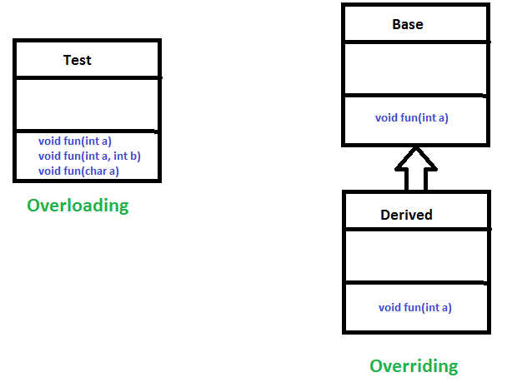

Slide 32
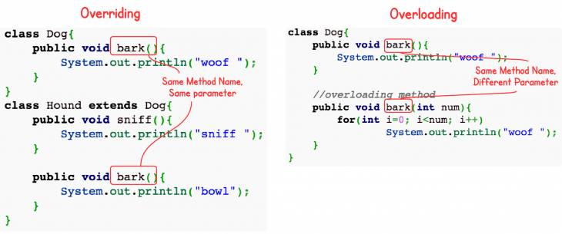

Slide 34
OOPs vs POPs
Object Oriented Programming |  | Procedural Oriented Programming
Program is divided into objects |  | Program is divided into functions
Emphasis on data(object) as compared to functions |  | Emphasis on Algorithm(function) as compared to data
It needs comparatively more memory |  | It needs less memory
Bottom up approach |  | Top down approach
Easy to modify/manage |  | Difficult to modify/manage
Objects communicate by passing messages |  | Main function calls other functions
Data is secure |  | Data is not secured
Java, Python |  | C, Pascal

Slide 35
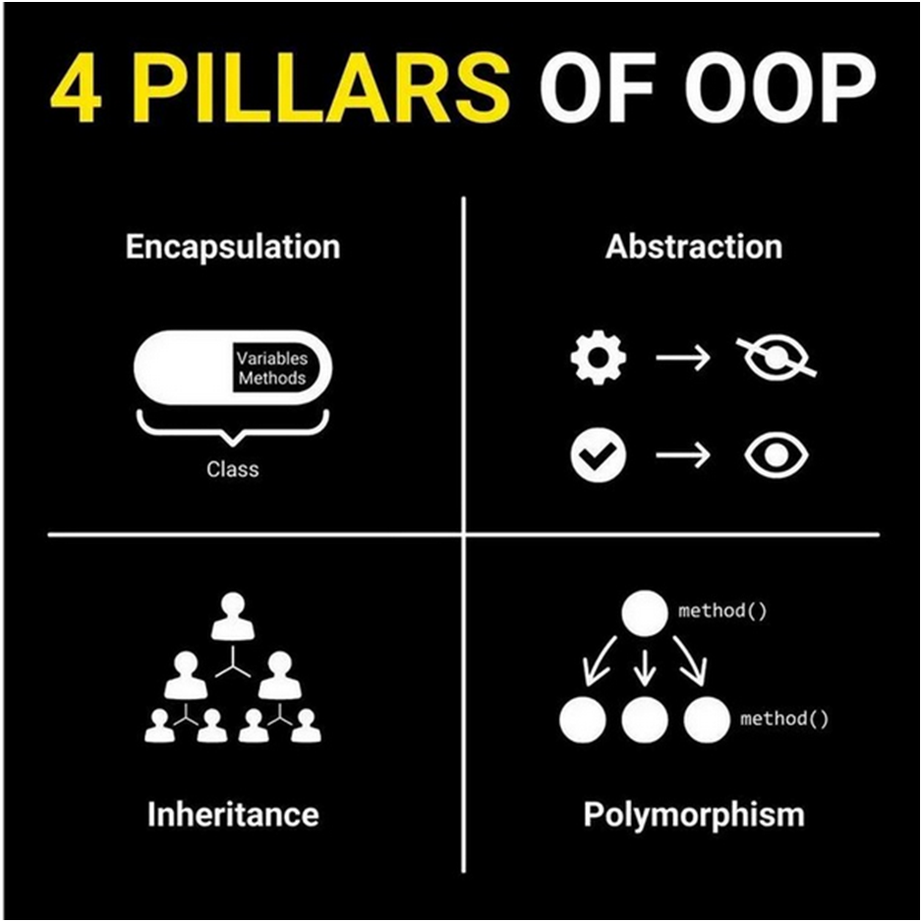

Slide 36
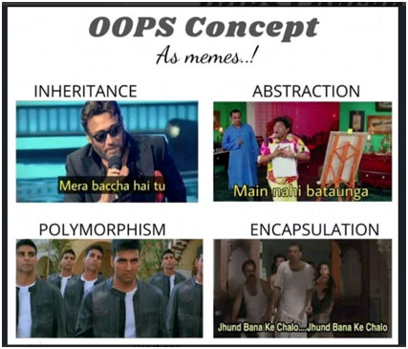

Slide 37
Quick Recap
What is OOP?
Object
Class
6 uses of ‘this’ keyword
‘New’ keyword
Constructor
Inheritance
‘super’ keyword
‘final’ keyword
Encapsulation
Data hiding
Access modifiers
Getters and Setters
Abstraction
Abstract class and Abstract method
Polymorphism
Method overloading
Method overriding

